Slide 1
Healthy Alaskans
Celebrating Success, Partnering for Progress
January 23, 2020
Notes:
This presentation is a celebration of much that has been accomplished and what’s yet to come as a part of Alaska’s State Health Improvement Plan, Healthy Alaskans.

Slide 2
Lisa McGuire, MPH, HA Co-Chair
Quality & Performance Improvement Manager
Director’s Office, Division of Public Health
Andrea Fenaughty, PhD, HA Data Team
Deputy Section Chief
Chronic Disease Prevention and Health Promotion, Division of Public Health
Cheryl Dalena, HA Co-Chair
Tobacco Program Coordinator
Wellness and Prevention Program
Alaska Native Tribal Health Consortium
Dana Diehl, HA Core Team
Wellness and Prevention Director
Community Health Services
Alaska Native Tribal Health Consortium
Notes:
This presentation was originally given in January of 2020. At the beginning of the new year we wanted to take a moment to take stock of how far we’ve come, and chart a course for the future. In this case we’re looking back at Healthy Alaskans 2020, and looking forward to Healthy Alaskans 2030.
bers of the Healthy Alaskans Core Team, we are co-presenting, just as we co-plan and implement Healthy Alaskans.

Slide 3
Overview
Healthy Alaskans history
The power of partnership
Successes, lessons learned from HA2020
HA2030: process and current status
Looking forward
Notes:
This presentation will cover:
Background on how Healthy Alaskans has evolved over the decades
The important role of partnership in this effort
A summary of successes and lessons learned in terms of the 2020 effort in particular
The work that’s already been done to set Healthy Alaskans 2030 in motion, and then finally
The 30 leading health indicators that were selected for 2030, and also wrap up with next steps and how you can get involved.

Slide 4
Healthy Alaskans History
HA 2000
HA 2010
HA 2020
Composition
What worked
Improvements
Notes:
We’ll begin by reviewing what the various past iterations of Healthy Alaskans have looked like in terms of scope, strengths, and limitations.

Slide 5
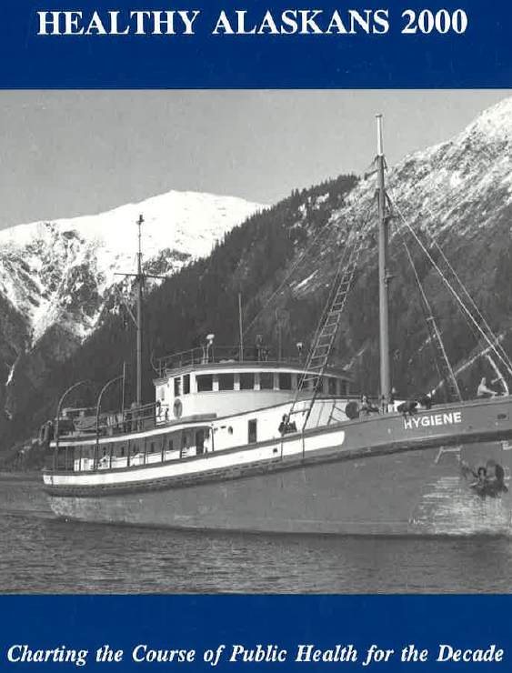
Healthy Alaskans 2000
More planning, coordination needed; HP 2000
Health Promotion, Health Protection, Preventive Services
140 indicators, targets (by subgroup)
Current trends, Recommendations, Key organizations
No regular monitoring
State led
Implementation plan?
Notes:
Healthy Alaskans 2000 was the 1st major planning effort since 1984 “State Health Plan for Alaska”
It was recognized at that time that the State of Alaska Department of Health and Social Services needed more information on which to base healthcare policy decisions
At the same time various federal initiatives, such as Healthy People 2000, were shining a light on the need to point to specific, measureable health objectives as a means to improve the health of the nation.
So Alaska followed the US Healthy People model by selecting health improvement objectives to reach for the following decade, 2000.
Healthy Alaskans 2000…
Focused on the areas of health promotion, health protection, and preventive services
Identified 140 indicators, many with subparts for different subpopulations. Also, targets for those indicators, and targets varied by subpopulation.
It was organized into sections on current data trends, recommendations for improvement, and named key organizations.
There was no systematic method for monitoring established.
The effort was led by the State of Alaska Department of Health and Social Services
And though the foreword in the book mentions a 5-year implementation plan that would be developed by I’ve not found any evidence that this happened.

Slide 6
Healthy Alaskans 2000
More planning, coordination needed; HP 2000
Health Promotion, Health Protection, Preventive Services
140 indicators, targets (by subgroup)
Current trends, Recommendations, Key organizations
No regular monitoring
State led
Implementation plan?
Notes:
Highlighted in green are the things that—in hindsight--were strengths, in red the things that didn’t work so well, were limitations
Strengths were that this—the first Healthy Alaskans effort—did foster a more coordinated approach to identifying and prioritizing health concerns in the state.
But limitations included that:
A large number of indicators were identified, without a mechanism for monitoring them.
Having different targets for subpopulations sent a message that it was acceptable for certain populations to achieve lower levels of improvement.
The state led this effort alone, and
There was no implementation plan linked to the plan.

Slide 7
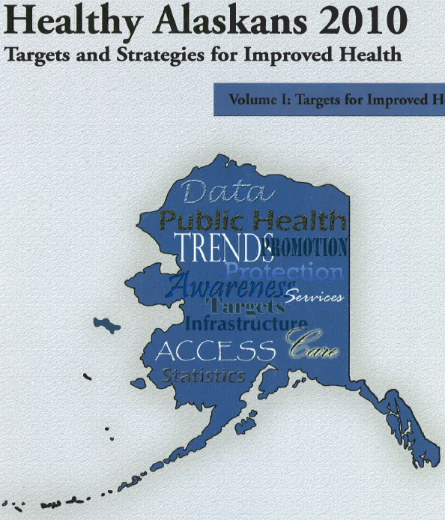
Healthy Alaskans 2010
Funding, Healthy Alaskans Partnership Council
Health Promotion, Health Protection, Preventive Services & Access, Infrastructure
400 plus indicators & targets, 23 Leading Health Indicators (LHIs).
overall targets; “developmental” objectives
Trends, Current Strategies & Resources
State led
No plan for monitoring
Vol 2: Stories of model AK programs
Notes:
The next decade’s health planning effort looked a little differently.
The state had funding to support a more broad-based planning effort.
The Healthy Alaskans Partnership Council was developed, with over 50 individuals representing state, local and tribal government, health care, non-profits, and academia to create the plan.
This planning effort developed over 400 indicators and targets--many of them “developmental”, where no data source had been identified. They also called out 23 leading health indicators, or LHIs
Volume I included data trends, and current strategies and resources.
Volume 2 was stories of model programs addressing some of the topic areas.
Again it was state led, and again there was no systematic monitoring plan.

Slide 8
Healthy Alaskans 2010
Funding, Healthy Alaskans Partnership Council
Health Promotion, Health Protection, Preventive Services & Access, Infrastructure
400 plus indicators & targets, 23 Leading Health Indicators (LHIs).
overall targets; “developmental” objectives
Trends, Current Strategies & Resources
State led
No plan for monitoring
Vol 2: Stories of model AK programs
Notes:
Again looking back, indeed we collected a little bit of data on the utility of this initiative, here is what was noted as strengths and limitations.
First strengths.
The fact we had this dedicated funding was an asset and really supported the more broad-based involvement of the Healthy Alaskans Partnership Council.
Having one set of targets for all subpopulations was an attempt to get at health equity.
Including Volume 2 was seen as useful as it provided some concrete examples of what works in Alaska.
But:
the number of indicators ballooned to 400+, without a way to systematically monitor them.
Many of these indicators were “developmental”, and were never developed during the decade, so we were unable to measure progress on those.
And it was still solely a State-led initiative.

Slide 9
Healthy Alaskans 2020
Initial NPHII funding
Co-Sponsored by DHSS and ANTHC
25 Leading Health Indicators
No “developmental” objectives
Included strategies and key partners
Implementation pilot
Commitment to monitoring (IBIS, Scorecards)
Web presence
County Health Rankings framework
Notes:
Finally, moving to Healthy Alaskans 2020.
This effort benefited from National Public Health Improvement Initiative funding to both ANTHC and the State
This mechanism was an opportunity for CDC to support state, tribal, local, and territorial public health departments to improve their efficiency and effectiveness.
This time around we focused on a much smaller set—25—of leading health indicators, all of which had to have identified sources.
We identified strategies and actions, key partners currently doing the work, and also had an implementation pilot focusing of 4 of the LHIs.
Ongoing data monitoring with online data dissemination was baked in from the beginning, with a web presence, and
It borrowed from the County health Rankings in terms of a framework on which to organize the different health topics.

Slide 10
Healthy Alaskans 2020
Initial NPHII funding (which ended prematurely)
Co-Sponsored by DHSS and ANTHC
25 Leading Health Indicators
No “developmental” objectives
Included strategies and key partners
Implementation pilot
Commitment to monitoring (IBIS, Scorecards)
Web presence
County Health Rankings framework
Notes:
One of the main limitations was that, unfortunately, the NPHII funding ended prematurely.
On the positive side:
This was a true jointly-sponsored effort between the State and ANTHC.
The focus on 25 LHIs and commitment to monitoring meant we had more accountability and transparency than ever.
There was more focus on implementation of the strategies—so: what will we actually do to move the needle in these areas--than in previous efforts.
And the increased web presence may have contributed to the increased brand recognition of HA2020.

Slide 11
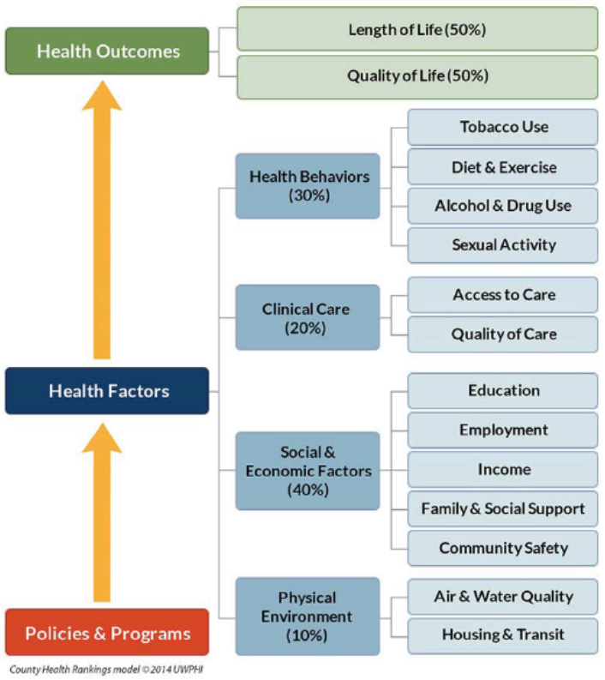
County Health Rankings Model
Notes:
This is just to show you the County Health Rankings model that divides health concerns into health outcomes, health factors, and then a set of smaller topical buckets.
We used this framework when working with various stakeholders to identify the leading health indicators to ensure we would end up with a comprehensive set of health priorities.
The next group of slides will touch on the more unique aspects of Healthy Alaskans.

Slide 12
What Makes HA2020 Unique?
Partnership
State and Tribal Government Partnership
Collective Impact Model
Collaborative efforts
Implementation of the plan
Strategies, Action, Key Partners
Commitment & Leadership
Notes:
Healthy Alaskans is an equal partnership between the Alaska Native Tribal Health Consortium and the State of Alaska Department of Health and Social Services.
The partnership is unique in that it’s the only known Statewide Health Improvement plan in the nation that is co-sponsored by State and Tribal governments, and the only plan that we know of where we have shared health improvement indicators, strategies and actions.
A primary reason that we decided on this partnership was because we knew that collaboration, and shared responsibility would move us closer to meeting our targets.
This partnership is also unique in that it’s rooted in the collective impact model which brings organizations with shared goals together, in a structured way, to achieve social change.
The partnership has allowed us to take Healthy Alaskans a step further by outlining not only leading health indicators but strategies, actions and key partners who can implement the plan. Without strategies, actions, key partners, we risk the plan sitting on a shelf and not being implemented.
Lastly, this partnership is unique in that we have leadership from both ANTHC and the State of Alaska that are committed to investing resources into making Healthy Alaskans successful. Both organizations dedicate staff time to the project including the two co-chairs, multiple core team members, data team members and communication team members.
At the outset of HA2020, a Memorandum of Agreement was signed by the DHSS commissioner at the time and the CEO of ANTHC. This agreement formalizes our partnership and commitment to the effort.

Slide 13
The Power of Partnership
“To Promote the Health
of Alaskans”
“Alaska Native people are the healthiest people in the world”
Notes:
This partnership was natural for both ANTHC and the State of Alaska for a number of reasons:
First, ANTHC and the State of Alaska are the two primary providers of statewide public health services in Alaska
This means we also have overlapping service jurisdictions
We were already working together on many established health programs, and professional relationships were already in place.
We also share similar visions and scopes of work: ANTHC’s vision is that Alaska Native people are the healthiest people in the world and the State Div. of Public Health’s mission is to promote the health of Alaskans
From ANTHC’s perspective, there were also multiple benefits to the Alaska Tribal Health System: the partnership allows us to bring tribal voices to the table, it ensures disparities among AN health status are addressed, and tribal organizations can use the health improvement plan as a framework to strengthen grant applications.

Slide 14
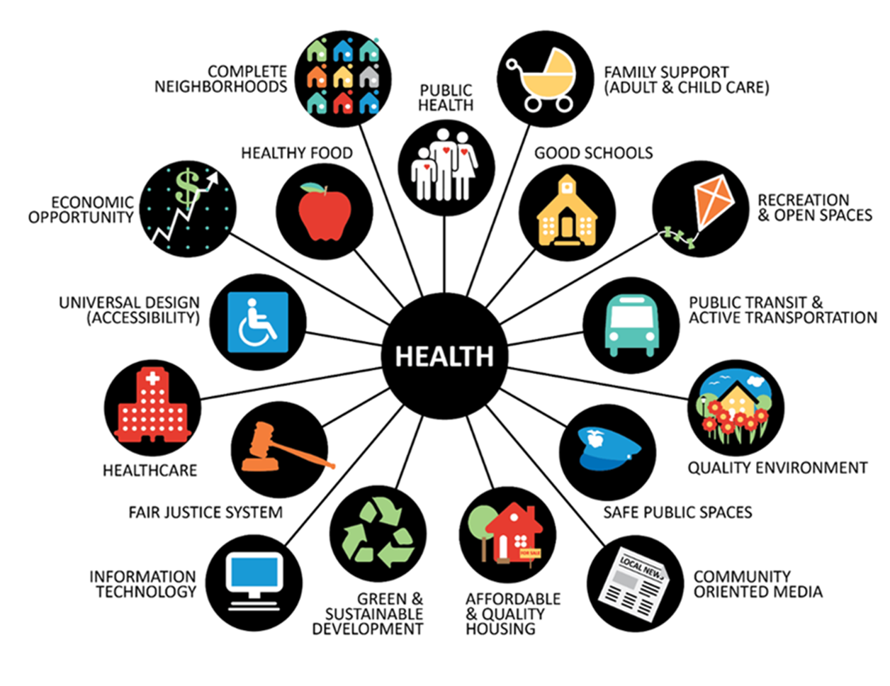
Collective Impact Model
Notes:
We mentioned that the health improvement plan is rooted in the Collective Impact Model so I want to take second to describe this.
We adopted this model because it brings organizations from many sectors together, in a structured way, to achieve social change.
The model focuses on having:
Backbone support
A common agenda
Mutually reinforcing activities
A shared measurement system, and
Continuous communication
Although it’s not always easy to implement collective impact, both organizations understand that in order for Healthy Alaskans to be successful, we do need to take implementation of each component of this model seriously.
The next group of slides will speak to some of our successes and lessons learned throughout the last decade.

Slide 15
Successes & Lessons Learned
Successes with HA2020 LHIs
Evaluation of the HA2020 process
Notes:
We shared what we perceived as strengths and limitations of HA2020.
We also wanted to summarize progress in terms of meeting targets, and also share the results of an evaluation of the process that was completed last year.

Slide 16
Progress on meeting HA2020 LHI Targets
Met
Cancer deaths
Teen smoking
Binge drinking
Education
Worsening
Obesity
Suicide
Rape
Water fluoridation
Notes:
First we’d like to remind everyone that although it is 2020, we don’t have 2020 data yet, and so have not yet had the final word on the extent to which the HA2020 targets were met. But here’s where we are as of the most recent update.
This chart shows progress for Alaskans overall.
At a glance you can tell that we are far from meeting all of our targets. We have met targets for about one quarter of the indicators, and are going the wrong direction for half.
This presentation will not walk you through progress on each of the LHIs, but just mention a few.
We met our targets for cancer deaths, teen smoking, binge drinking, and graduating with a high school diploma
We’re going the wrong direction in obesity, suicide, rape and water fluoridation.
We will be updating the scorecard again later this Winter, then a final time in 2021.

Slide 17
Progress on meeting HA2020 LHI Targets
Met
Teen dating violence
Teen binge drinking
Healthcare access
Insufficient Progress
Prenatal care
Cancer
Smoking
Worsening
Obesity
Suicide (25+)
Chlamydia
Notes:
Now focusing on progress among Alaska Native people exclusively, You can see fewer targets were met, but also more were making little progress rather than worsening.
Some of the areas where we saw progress among Alaska Native people were teen dating violence, teen binge drinking, and cost as a barrier to healthcare.
There was some progress but not enough to appear likely to meet the targets in the areas of prenatal care, cancer deaths, and smoking.
And here we’ll remind you that we used the same targets for Alaska natives and all Alaskans—even where baselines were different. So for some of the leading health indicators we would have had to have seen much more progress in the Alaska Native trend to have the target met.
As with Alaskans overall, we saw worsening among Alaska Native people in obesity and suicide among those 25 and older, and also cases of chlamydia.
There are probably many reasons that contributed to why we have had differential success across the LHIs. In some cases we may have set unrealistic targets a decade ago. In others, we may have capitalized on momentum that was building, not only in Alaska but nationwide.
These factors and others are being considered as we work on the next iteration of Healthy Alaskans.

Slide 18
Healthy Alaskans 2020 – Evaluation (2019)
Strengths:
State – ANTHC Partnership
Focus on 25 LHIs – clear goals
Scorecards
Challenges:
Many staff transitions, lacking transition plan
Strategies and actions static
Lack of funding
Implementation pilot was limited
Notes:
Looking at a summary of progress on the LHIs is one important way to evaluate Healthy Alaskans. And as we saw, we all have a lot of work to do to keep making progress toward our collective health priorities.
To help shape what that work looks like, we undertook an evaluation of the Healthy Alaskans process with an MPH student
We conducted a number of individual interviews with member of the various teams and identified the following themes.
Strengths noted almost across the board were: the State-ANTHC partnership, a narrowly defined set of health priorities, and the fact we were systematically monitoring and reporting our progress on the LHIs.
Noted challenges were:
The fact that there were many staff transitions over the decade and transition planning was not what it could have been.
The strategies and actions were really only identified once—at the beginning, and never updated.
The implementation pilot was not as robust as initially planned. And perhaps underlying all of these limitations is that fact that:
The funding that would have supported a lot of the work ended prematurely.

Slide 19
Healthy Alaskans 2030:
Process & Current Status
Notes:
The following set of slides will discuss all the great work that’s been going on related to Healthy Alaskans 2030.

Slide 20
Healthy Alaskans 2030 Structure
Steering Team
Subject Expertise Teams
Alaskans, Workgroups
Core Team
Advisory Team
Notes:
This is what the Healthy Alaskans structure looks like. As you can see, the Healthy Alaskans is TEAM BASED which allows for continuous collaboration towards statewide health improvement. This structure has been in place throughout Healthy Alaskans 2020 and is a carry over to 2030 because it has worked well.
We really want to emphasize that the state health improvement plan is truly a statewide team effort. It’s not just about the backbone entities; we just set the framework and process. The plan is about the workgroups, organizations, communities and individuals who have been involved throughout the decades; ie. all of YOU.
At the base of this graphic is the foundation of the Healthy Alaskans effort; input from Alaskans, communities, organizations working in health and areas that impact health, and the various workgroups that have worked so hard to maintain HA2020 and develop HA2030.
Above that is the Data, Communications and other subject matter teams and experts. Healthy Alaskans is all about evidence based action for health improvement and these teams make sure that we use evidence and data to propel us forward in our efforts.
The Advisory Team is made up of approximately 40 professionals from the broader public health arena in Alaska who are subject matter experts in topics that span the entire spectrum of public health services and functions including nonprofit, state, Tribal, private and other entities working in environmental health issues, injury prevention, mental health, housing, chronic disease and other public health areas.
The Advisory Team uses their professional expertise to make recommendations to the Core Team regarding leading health indicators, strategies, implementation and process. The Advisory Team also serves as active champions of Healthy Alaskans, promoting it among their networks and colleagues, and aligns their work with Healthy Alaskans goals as appropriate.
The core team is made up of approximately 10 professionals who represent various expertise within the two backbone entities; ANTHC and DHSS. The Core team is led by the two Co-Chairs and oversees the timeline of HA activities which form the framework for the state health improvement plan.
The top of this diagram illustrates the high level of commitment to the state health improvement plan by ANTHC and the State of Alaska. The Steering Team members are the leadership of DHSS and ANTHC.
Healthy Alaskans is truly statewide effort and it’s only together that we can achieve the goals of the state health improvement plan.
This is the State health improvement plan and it shows that we are all invested. WE ARE HEALTHY ALASKANS!

Slide 21
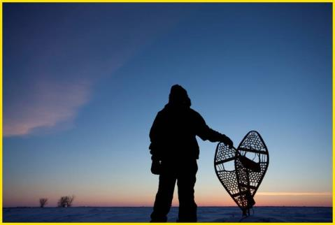
Healthy Alaskans 2030
Vision: Healthy Alaskans in Healthy Communities
Mission: Provide a framework and foster partnerships to optimize health for all Alaskans and their communities
Notes:
As mentioned, Healthy Alaskans 2030 is unique in that it is the only State Health Improvement plan in the nation that is co-led by State and Tribal governments, that share health improvement goals. We want to re-emphasize that because it is a point of pride for us.
Healthy Alaskans was born out of a spirit of collaboration and sustained commitment to quality improvement.
The Vision Statement and Mission Statement were developed back in 2010 when Healthy Alaskans 2020 began, and still hold true today.

Slide 22
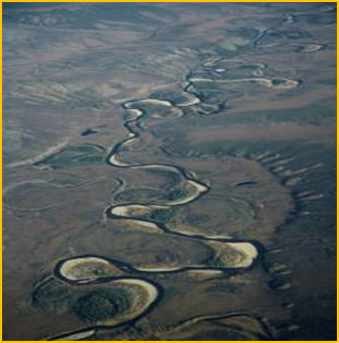
Healthy Alaskans 2030
Guiding Principles
Strong partnerships with mutual accountability
Health Equity
Quality of life across the lifespan
Using the best scientific research and data, and local knowledge from our diverse cultures
Strengthening communities & empowering individuals
Notes:
The guiding principles developed back in 2010 also hold true to this day and will remain in place throughout the life of HA2030.
The partnership is committed to:
Using evidence as well as local knowledge from our many diverse cultures
Working collaboratively and being transparent and mutually accountable
Striving for Health equity for all Alaskans
Strengthening communities ,
empowering individuals and
Ensuring Quality of life across the lifespan

Slide 23
Development of HA2030
Assessment
State Health Assessment
Quantitative & Qualitative
Community Capacity Review
HA2020 Evaluation
Notes:
Like all good public health efforts, we had to collect a great deal of data to inform our actions. Development of Healthy Alaskans 2030 required a thorough assessment of the current health status of Alaskans in the form of quantitative and qualitative data.
We collected the numbers and data that show us what health issues and conditions Alaskans are experiencing, we collected information about what health issues are most important to Alaskans through surveys, listening sessions and interviews. We partnered with public health nursing, the Anchorage Health Department, and the ANTHC Community Health Aide Program among others to do this.
We also conducted an assessment of Alaska’s public health system using the National Public Health Performance Standards state instrument or what we called the community capacity review, and, as mentioned we conducted an evaluation of the Healthy Alaskans 2020 effort.
All of these results are summarized in the State Health Assessment report which is posted on our website and which was used to develop an understanding of the state of Alaska’s health overall in order to inform Healthy Alaskans 2030.

Slide 24
HA2030 Indicator Selection Process
Considerations:
State Health Assessment
Community Capacity Review
Evaluation/Lessons Learned
Framework
Data trends
HA2020 scorecards
Advisory Team recommendations
Criteria:
Important
Actionable, relevant
Comprehensive
Upstream
Lifespan
Available, valid, and reliable data
AK/US comparison
Notes:
All of the data collected in the state health assessment, public health system assessment, evaluation, review of HA2020 data trends and performance, as well as recommendations from subject matter experts were considered when conducting the process of deciding which leading health indicators were compelling enough to include in the next iteration of the state health improvement plan.
We also established criteria for LHI selection which were that the indicator had to be
Important and understandable to a broad audience,
Actionable,
Have a trusted data source that is available preferably on an annual basis,
And Have an AK/US comparison

Slide 25
HA2030 Indicator Selection Process
Data Team and Subject Matter Expert Input and recommendations
Input from Alaskans
Survey
Conferences
Focus groups
Community Listening Sessions
Advisory Team
Recommended 30
Indicators
Core and Data Team Additional Research and LHI refinement
Steering Team
Approved final Indicators
Establish targets and evidence based strategies
HA2030 Leading Health Indicators
Notes:
Taking all the criteria and considerations into account, the teams moved forward to make recommendations for the 2030 Leading Health Indicators. All teams at every level were involved in vetting, discussing and refining these indicators.
This slide shows the general process that we have followed thus far to develop Healthy Alaskans 2030.

Slide 26
Introducing
HA2030
Health Topics
&
Leading Health Indicators
Notes:
After the vast body of work that has been done this past year
With the help of so many Alaskans
We present to you, the HA 2030 LHIS
As you scroll through these, you will note that they cross the lifespan-young children, adolescents, adults, elders as well as
Crossing many health topics that were important to Alaskans
NOTE: Final versions will be published in the State Health Improvement Document(SHIP) later this year and may contain some language revisions.

Slide 27
HA2030 Leading Health Indicators
Chronic Disease
1. Reduce the cancer mortality rate per 100,000 population
Environmental Health
2. Increase the percentage of rural community housing units with water and sewer services
3. Increase the percentage of the Alaskan population served by community water systems with optimally fluoridated water
Notes:
You will also note that these are broken out and arranged by priority health topics and that they are aligned with the County Healthy Rankings framework.
NOTE: Final versions will be published in the State Health Improvement Document(SHIP) later this year and may contain some language revisions.

Slide 28
HA2030 Leading Health Indicators
Healthcare Access
Reduce the percentage of women delivering live births who have not received prenatal care beginning in first trimester of pregnancy
Reduce the percentage of adults (aged 18 years and older) reporting that they could not afford to see a doctor in the last 12 months
Reduce the rate of preventable hospitalizations per 1,000 adults (hospitalizations that could have been prevented with high quality primary and preventive care) based on the Agency for Healthcare Research and Quality (AHRQ) definition
Increase the percentage of 3-year olds who have had a well-child checkup in the last 12 months
Reduce the percentage of the population without health insurance
Notes:
This group addresses:
Prenatal care
Healthy care Affordability
Preventative hospitalizations
Well child check-ups
Increasing population with Health insurance

Slide 29
HA2030 Leading Health Indicators
Healthy Weight
Increase the percentage of children (students in grades K-8) who meet criteria for healthy weight
Infectious Disease
Increase the vaccination coverage level of 4 doses of diphtheria-tetanus-acellular pertussis (DTaP) vaccine among children by age 2 years
Reduce the incidence rate of gonorrhea per 100,000 population
Injury Prevention
Reduce the unintentional injury mortality rate per 100,000 population
Notes:
This group addresses:
Healthy weight in children-from HA2020, this is a change from overweight and obese indicators to healthy weight in children
Vaccine coverage-from HA2020, this new language is based on CDC and healthy people changes
Gonorrhea –from HA2020, this is a change from focus on Chlamydia
Unintentional injury-no change

Slide 30
HA2030 Leading Health Indicators
Mental Health
Reduce the percentage of adolescents (high school students in grades 9-12) who felt so sad or hopeless every day for 2 weeks or more in a row that they stopped doing some usual activities during the past 12 months
Reduce the mean number of days in the past 30 days adults (aged 18 years and older) report being mentally unhealthy
Nutrition
Reduce the percentage of 3-year olds who drink any sugary drinks on a given day
Notes:
This group has a focus on:
Adolescents feeling hopeless or sad
Adults being mentally healthy
Sugary drinks young children

Slide 31
HA2030 Leading Health Indicators
Physical Activity
Increase the percentage of adolescents (high school students in grades 9-12) who meet the Physical Activity Guidelines for Americans (2008 US DHHS Physical Activity Guidelines: adolescents who do at least 60 minutes of physical activity a day, every day of the week)
Protective Factors
Increase the percentage of adolescents (high school students in grades 9-12) with 3 or more adults (besides their parent(s)) who they feel comfortable seeking help from
Increase the percentage of adolescents (high school students in grades 9-12) who feel like they matter to people in their community
Notes:
This group focuses on:
Adolescents meeting physical activity guidelines
Protective Factors-Many of the health topic workgroups discussed the impact and importance of addressing and including protective factors in the plan during their work sessions. At this time, these two are specifically addressed in the plan while many LHI areas refer to protective factors in strategies and actions or work group members noted a need for future protective factor strategy and action development work.
Adolescents who have supportive adults
Adolescents who feel they matter

Slide 32
HA2030 Leading Health Indicators
Social Determinants of Health
Increase the percentage of high school students who graduate within 4 years of starting 9th grade
Reduce the percentage of rental occupied households that exceed 50 percent of household income dedicated to housing
Increase the percentage of residents (all ages) living above the federal poverty level (as defined for AK)
Notes:
This group focuses on :
Graduate in 4 years
Increasing affordable housing
Increasing Alaskans living above the poverty level

Slide 33
HA2030 Leading Health Indicators
Substance Misuse
Reduce the alcohol-induced mortality rate per 100,000 population
Reduce the drug-induced mortality rate per 100,000 population
Reduce the percentage of adults needing but not receiving substance use disorder treatment
Suicide Prevention
Reduce the suicide mortality rate per 100,000 population, among the population aged 15 and older
Notes:
This group focuses on:
Substance Misuse:
Alcohol and drug induced mortality
Substance use disorder treatment
Suicide indicator changed from 2 indicators in the 2020 plan. (15-24 and 25 and up) now it is one indicator 15 and older
NOTE: Final versions will be published in the State Health Improvement Document(SHIP) later this year and may contain some language revisions.

Slide 34
HA2030 Leading Health Indicators
Tobacco Use
Reduce the percentage of adolescents (high school students in grades 9-12) who have used electronic vapor products, cigarettes, smokeless tobacco, or other tobacco products in the last 30 days
Reduce the percentage of adults (aged 18 years and older) who currently smoke cigarettes or use electronic vapor products, smokeless tobacco, or other tobacco products
Notes:
Tobacco Use is addressed through and adolescent and adult specific indicator and now includes electronic vapor products and other tobacco products

Slide 35
HA2030 Leading Health Indicators
Violence Prevention
Reduce the percentage of repeated substantiated child maltreatment within last 12 months
Reduce the rate of reported and attempted rape per 100,000 population
Reduce the percentage of adolescents (high school students in grades 9-12) who were ever hit, slammed into something, injured with an object or weapon, or physically hurt on purpose by someone they were dating or going out with during the past 12 months.
Notes:
This group focuses on:
Child maltreatment
Reported and attempted Rape
Adolescent dating violence

Slide 36
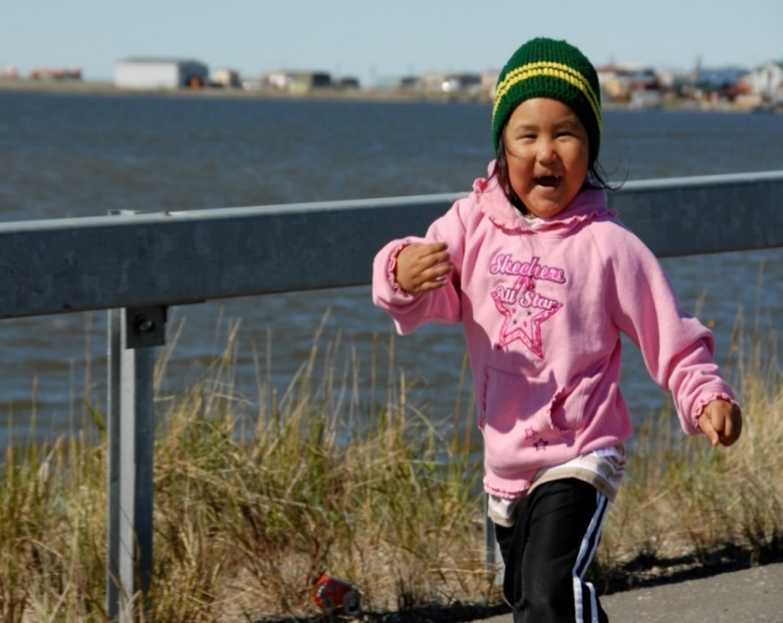
HA2030 Strategies and Actions for Success
Healthy Alaskans is more than 30 Leading Health Indicators
Evidence Based Strategies and Actions
Implementation Framework
Notes:
Through this presentation, you’ve seen all the Leading Health Indicators yet It is not enough to have just the leading health indicators.
Healthy Alaskans is so much more!
-One strength of Healthy Alaskans, our state health improvement PLAN is that it also includes strategies and actions that were developed by teams of subject matter and data experts, healthy Alaskans core team members and Advisory Team members and many of you!
The strategies and actions can be implemented with the aim of moving the needle closer to the established target.
The teams:
Identified evidence based strategies- broad based method, approach, or process used to achieve a desired outcome.
those that have been demonstrated to achieve the desired results.
Identified Action steps for each strategy - specific activity or intervention that is measurable; emphasis on work underway or budgeted for the near future
Identified Key Partners for each action step - group or individual responsible, willing or participating in implementing, monitoring, and reporting on the status of one or more action steps
-Teams met over a 10 to 12 week period to review performance trends for a each LHI, reviewed evidenced based strategies and offered what they believed are the best recommended actions that can be taken by organizations, communities, and partners to help move the needle toward the target.
Through this process, key partners were also identified.
Our health improvement plan also provides a model implementation framework focusing on existing work, collaborative efforts, aligning efforts through
partners
Community of practice
The healthy Alaskans coordinators and core team
working collectively toward reaching the 30 health goals,

Slide 37
Healthy Alaskans 2030: Full Steam Ahead
January 2020 - Completion of strategies and actions
February 2020 - New Website https://www.healthyalaskans.org
February 2020 - Public comment period of Healthy Alaskans 2030, State Health Improvement Plan
March 2020 - Comprehensive State Health Improvement Plan document finalized & published
2020-2030 - Focus on structured, sustained implementation efforts and monitor progress
Notes:
Now that the LHIs and evidence-based strategies have been selected, implementation is needed to reach the 2030 targets. Implementation will be a primary focus of Healthy Alaskan 2030 moving forward.
2020-2030
YOU are Healthy Alaskans-you help reach these goals every day; lets think and work collectively

Slide 38
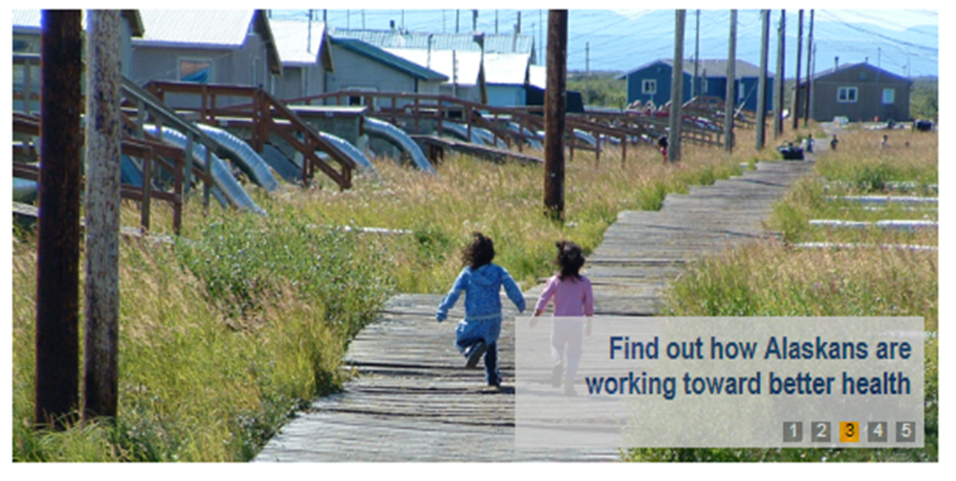
YOU can get involved!
Visit the Healthy Alaskans website
Sign up to receive updates on news and activities
Join or initiate an implementation team
Align your work with HA2030 goals and strategies
Use Healthy Alaskans data
Spread the word about HA2030!
Notes:
The new website www.healthyalaksans.org is coming soon-we are beginning to populate it with new information and the 2020 site will stay active at this time
We encourage you to think about how you, your organization or entity or family are implementing HA or your work is aligned to help reach HA goals.
Please think about the HA data and how you are using or can use it.
Please be an advocate for health improvement and spread the word about Healthy Alaskans, OUR STATE HEALTH IMPROVEMENT PLAN!

Slide 39
Connect with Healthy Alaskans
Cheryl Dalena
cadalena@anthc.org
Dana Diehl
dadiehl@anthc.org
Andrea Fenaughty, PhD
Andrea.Fenaughty@alaska.gov
Lisa McGuire, MPH
Lisa.mcguire@alaska.gov
Healthy Alaskans Email
healthyalaskans@alaska.gov
New Website Coming Soon!!
https://www.healthyalaskans.org
Notes:
THANK YOU for your time today and the work you do everyday toward achieving the goals of Healthy Alaskans!

